Slide 1


Statistical Modelling Project
HENRY GIORGI
Data Science Bootcamp

Slide 2
Agenda
1. Project Flow Structure
2. Results
3. Biggest Challenges

Slide 3
1. PROJECT FLOW STRUCTURE
CityBikes
4square + Yelp
Merging
Linear Regression Model
Toronto, ON
Data: ID, Name of Stations + Coordinates + #of_Bikes
Filter:
Radius = 1000m Vars: Rating, Review_count, Distance to bike stations,
Bikes Toronto =
CB + Yelp
Stats + Visual
Interpretation R-square
P-values
DF + CSV
DF + CSV
DF + SQLiteDB
REG. MODEL

Slide 4
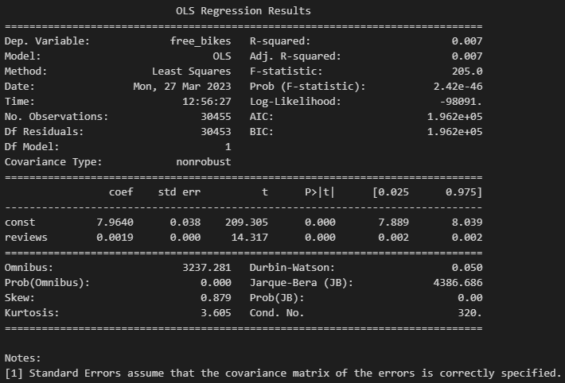
2. results
Backward Selection method
Dependent variable: free_bikes
Independent variable: reviews (‘dist2station’ and ‘rating’ variables were dropped)

Slide 5

3. Biggest Challenges
If I had more time:
I would try to implement more categories with the APIs.
I would do the classification model.

Slide 6
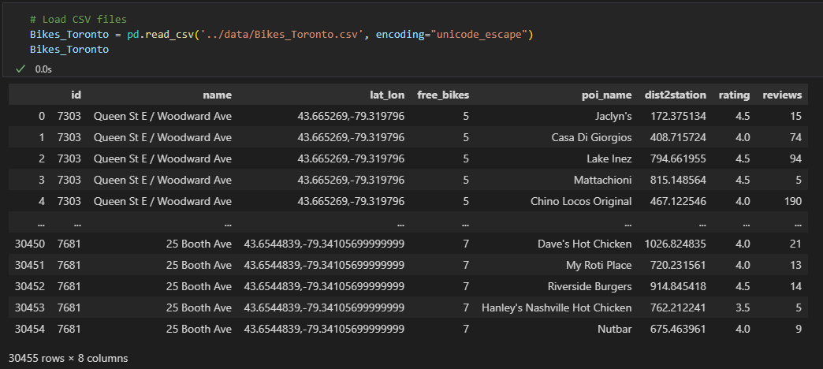
3. Biggest Challenges

Slide 7
Thank you

